Slide 1
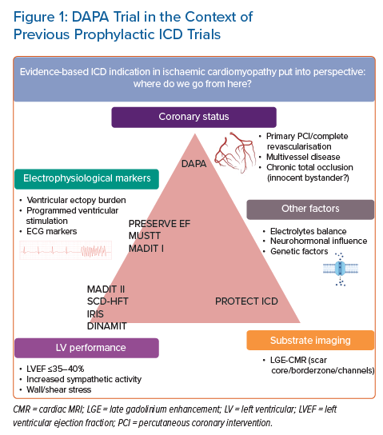
Haanschoten D, Elvan A
DAPA Trial in the Context of Previous Prophylactic ICD Trials
Citation: Arrhythmia & Electrophysiology Review 2021;10(3):154–8.
https://doi.org/10.15420/aer.2021.23

