Slide 1
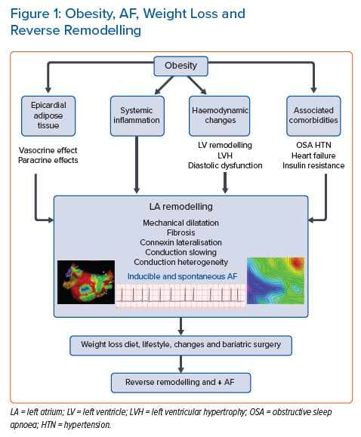
Al-Kaisey AM, Kalman JM
Obesity, AF, Weight Loss and Reverse Remodelling
Citation: Arrhythmia & Electrophysiology Review 2021;10(3):159–64.
https://doi.org/10.15420/aer.2021.36

