Slide 1
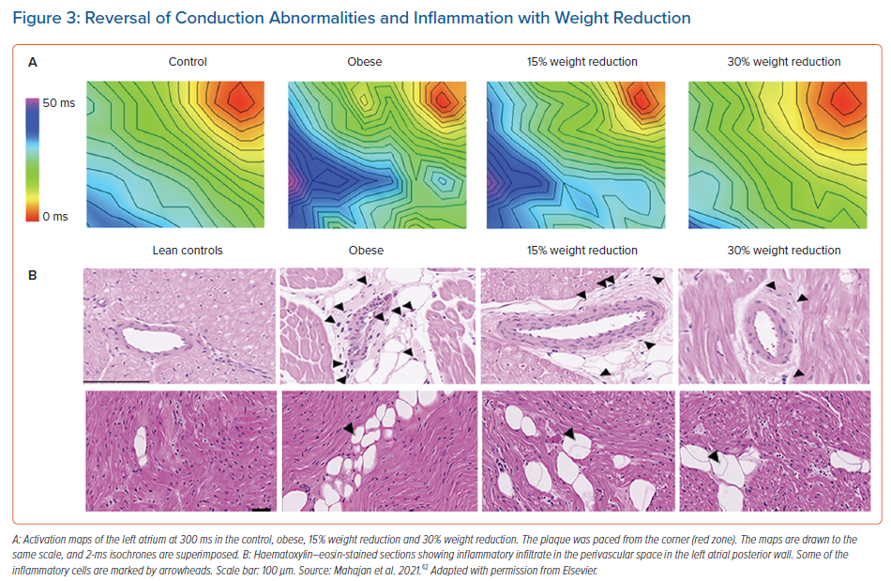
Al-Kaisey AM, Kalman JM
Reversal of Conduction Abnormalities and Inflammation with Weight Reduction
Citation: Arrhythmia & Electrophysiology Review 2021;10(3):159–64.
https://doi.org/10.15420/aer.2021.36

