Slide 1
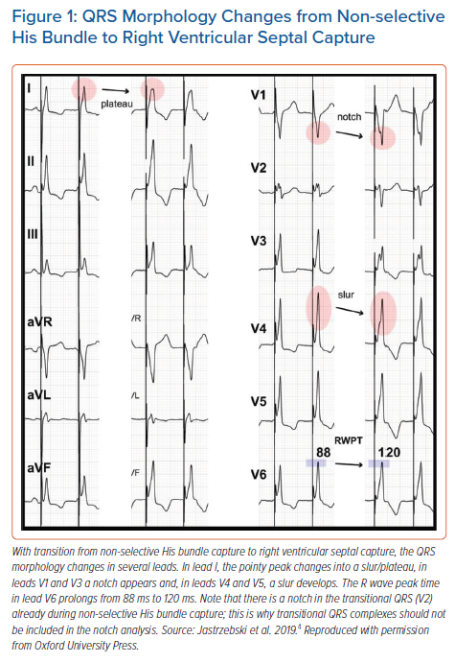
Jastrzębski M
QRS Morphology Changes from Non-selective His Bundle to Right Ventricular Septal Capture
Citation: Arrhythmia & Electrophysiology Review 2021;10(3):172–80.
https://doi.org/10.15420/aer.2021.26

