Slide 1

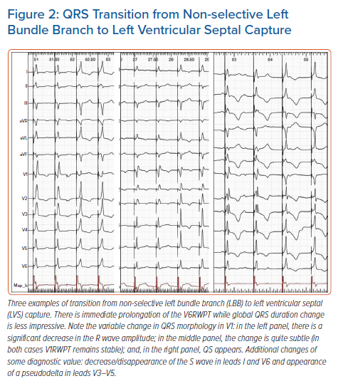
Jastrzębski M
QRS Transition from Non-selective Left Bundle Branch to Left Ventricular Septal Capture
Citation: Arrhythmia & Electrophysiology Review 2021;10(3):172–80.
https://doi.org/10.15420/aer.2021.26

