Slide 1
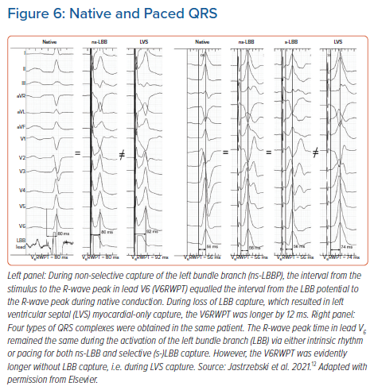
Jastrzębski M
Native and Paced QRS
Citation: Arrhythmia & Electrophysiology Review 2021;10(3):172–80.
https://doi.org/10.15420/aer.2021.26

