Slide 1
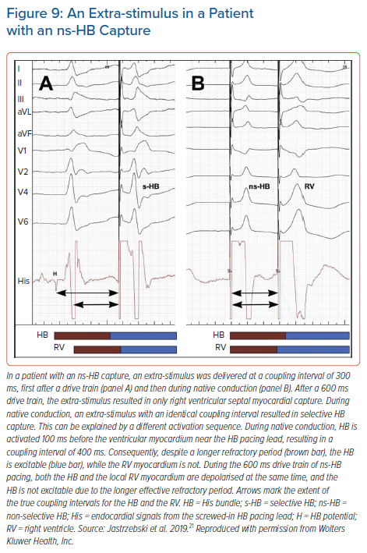
Jastrzębski M
An Extra-stimulus in a Patient with an ns-HB Capture
Citation: Arrhythmia & Electrophysiology Review 2021;10(3):172–80.
https://doi.org/10.15420/aer.2021.26

