Slide 1

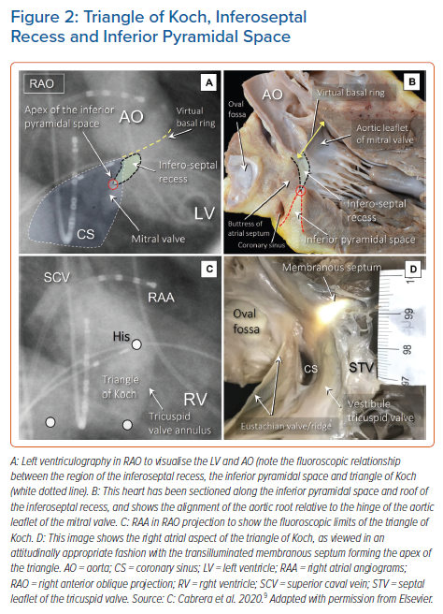
Cabrera J�, Anderson RH, Porta-Sánchez A, Macías Y, Cano �, Spicer DE, Sánchez-Quintana D
Triangle of Koch, Inferoseptal Recess and Inferior Pyramidal Space
Citation: Arrhythmia & Electrophysiology Review 2021;10(3):181–9.
https://doi.org/10.15420/aer.2021.32

