Slide 1
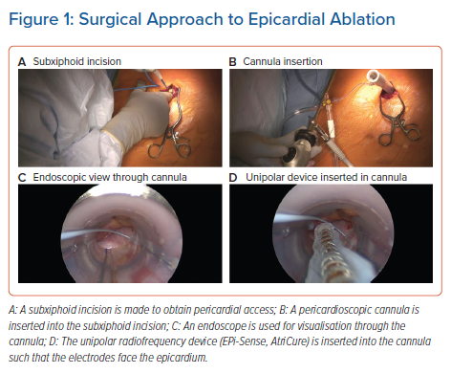
DeLurgio D, Gill J, Ahsan S, Kaba R, Plasseraud KM, Halkos ME
Surgical Approach to Epicardial Ablation
Citation: Arrhythmia & Electrophysiology Review 2021;10(3):198–204.
https://doi.org/10.15420/aer.2021.24

