Slide 1
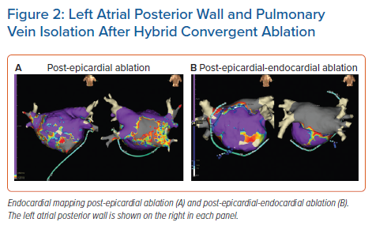
DeLurgio D, Gill J, Ahsan S, Kaba R, Plasseraud KM, Halkos ME
Left Atrial Posterior Wall and Pulmonary Vein Isolation After Hybrid Convergent Ablation
Citation: Arrhythmia & Electrophysiology Review 2021;10(3):198–204.
https://doi.org/10.15420/aer.2021.24

