Slide 1
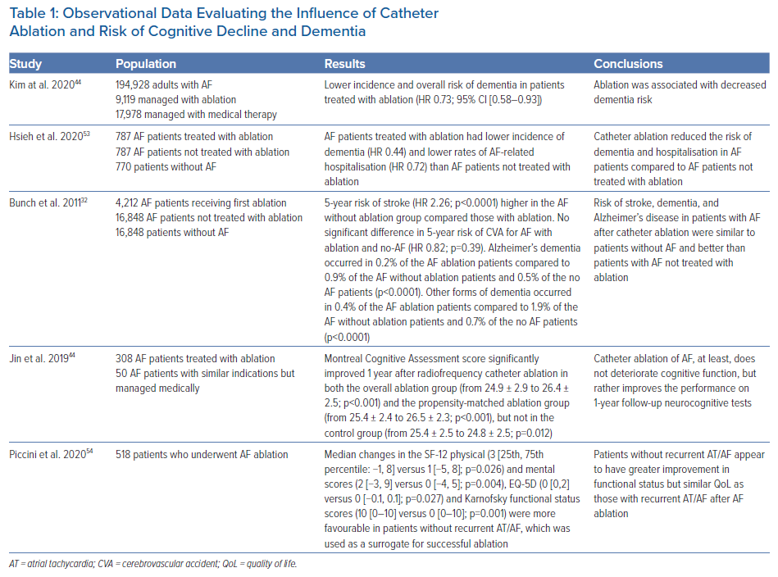
Burnham TS, Scott ML, Steinberg BA, Varela DL, Zenger B, Bunch TJ
Observational Data Evaluating the Influence of Catheter Ablation and Risk of Cognitive Decline and Dementia
Citation: Arrhythmia & Electrophysiology Review 2021;10(3):205–10.
https://doi.org/10.15420/aer.2021.42

