Slide 1
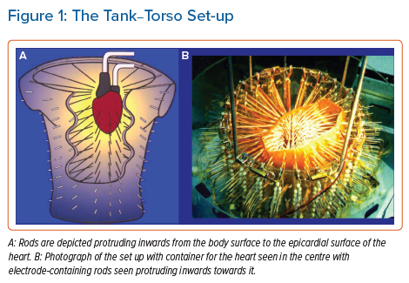
Graham AJ, Schilling R
The Tank–Torso Set-up
Citation: Arrhythmia & Electrophysiology Review 2021;10(3):211–7.
https://doi.org/10.15420/aer.2021.27

