Slide 1
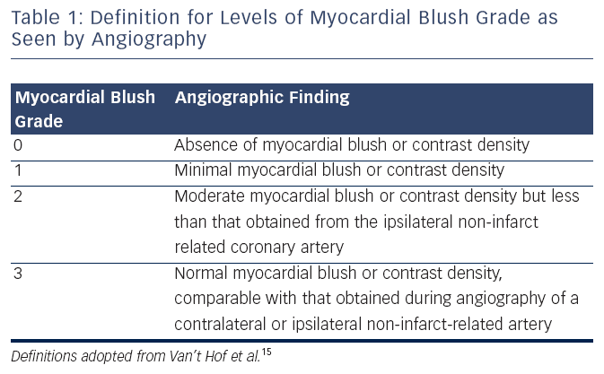
Tsang M, Jolly S
Table 1: Definition for Levels of Myocardial Blush Grade as Seen by Angiography
Citation: Interventional Cardiology Review 2015;10(1):35–8
https://doi.org/10.15420/icr.2015.10.1.35

