Slide 1
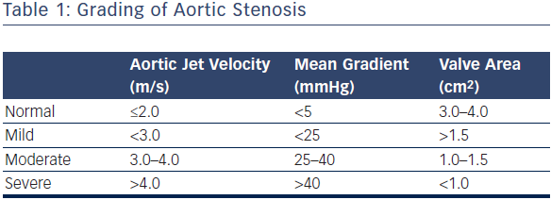
Noorani A, Bapat V
Table 1: Grading of Aortic Stenosis
Citation: Interventional Cardiology Review 2014;9(2):121–5
https://doi.org/10.15420/icr.2011.9.2.121

