Slide 1

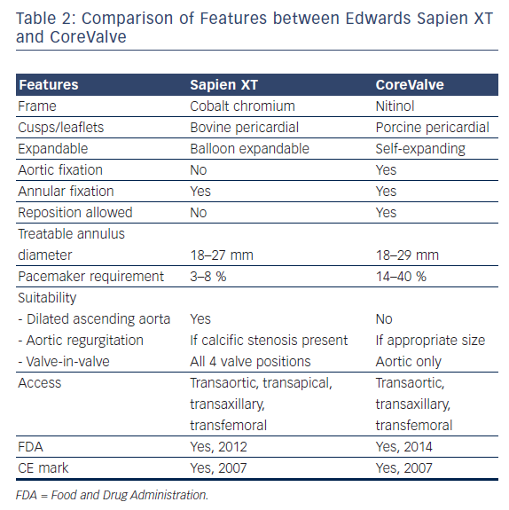
Noorani A, Bapat V
Differences in Outcomes and Indications between Sapien and CoreValve Transcatheter Aortic Valve Implantation Prostheses
Citation: Interventional Cardiology Review 2014;9(2):121–5
https://doi.org/10.15420/icr.2011.9.2.121

