Slide 1
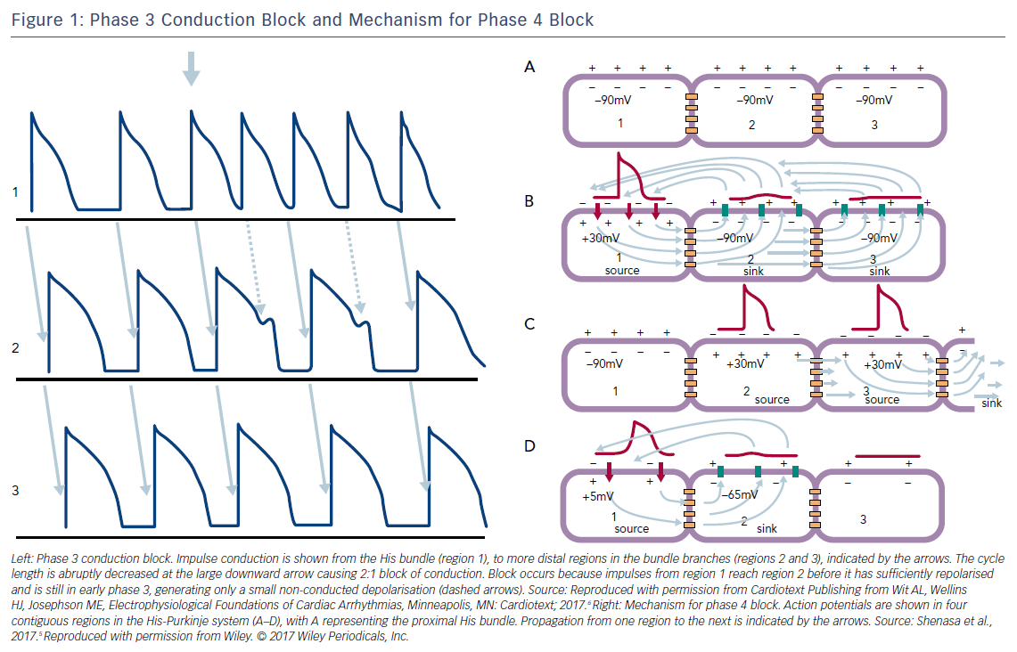
Katritsis DG
Figure 1: Phase 3 Conduction Block and Mechanism for Phase 4 Block
Citation: Arrhythmia & Electrophysiology Review 2018;7(2):77–8.
https://doi.org/10.15420/aer.2018.7.2.EO1

