Slide 1

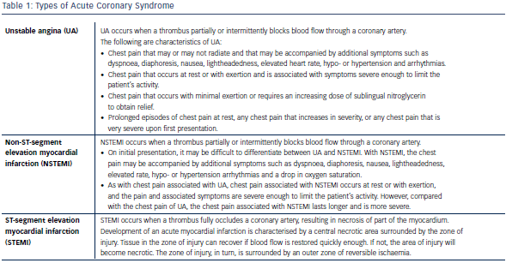
Chan K, Lee SW
Table 1: Types of Acute Coronary Syndrome
Citation: RadcliffeCardiology.com, July 2014

