Slide 1
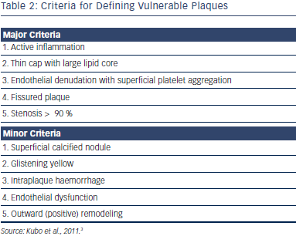
Chan K, Lee SW
Clinical Utilisation of Optical Coherence Tomography in Acute Coronary Syndromes
Citation: RadcliffeCardiology.com, July 2014

