Slide 1
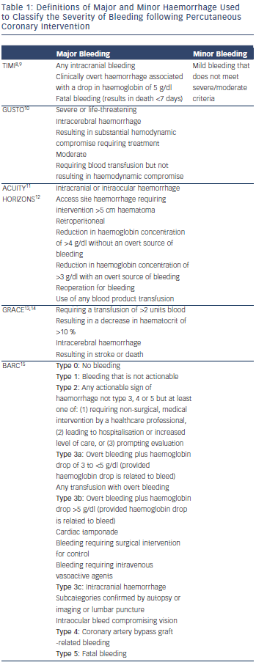
Holroyd EW, Khoo CW, Butler R, Fraser DG, Nolan J, Mamas MA
Table 1: Definitions of Major and Minor Haemorrhage Used to Classify the Severity of Bleeding following Percutaneous Coronary Intervention
Citation: Interventional Cardiology Review 2015;10(1):22–5
https://doi.org/10.15420/icr.2015.10.1.22

