Slide 1
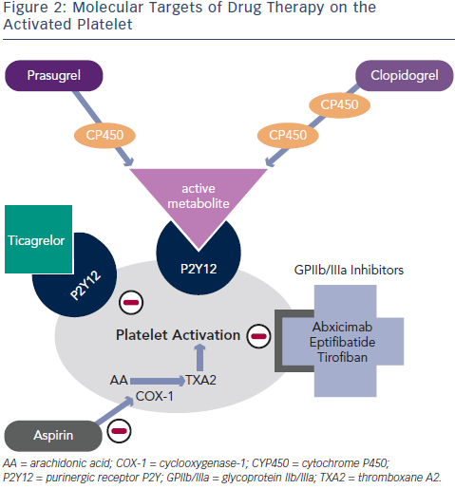
Raveen Kandan S, Johnson TW
Contemporary Antiplatelet Strategies in the Treatment of STEMI using Primary Percutaneous Coronary Intervention
Citation: Interventional Cardiology Review 2015;10(1):26–31
https://doi.org/10.15420/icr.2015.10.1.26

