Slide 1
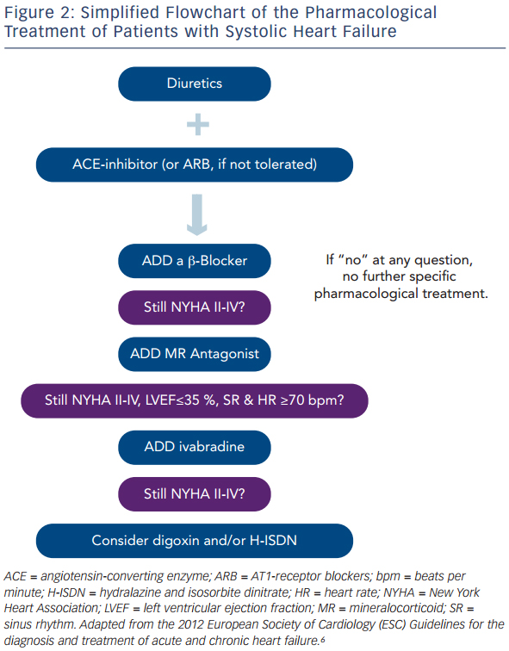
Maack C, Böhm M
Figure 2: Simplified Flowchart of the Pharmacological Treatment of Patients with Systolic Heart Failure
Citation: European Cardiology Review 2014;9(1):43–8
https://doi.org/10.15420/ecr.2014.9.1.43

