Slide 1
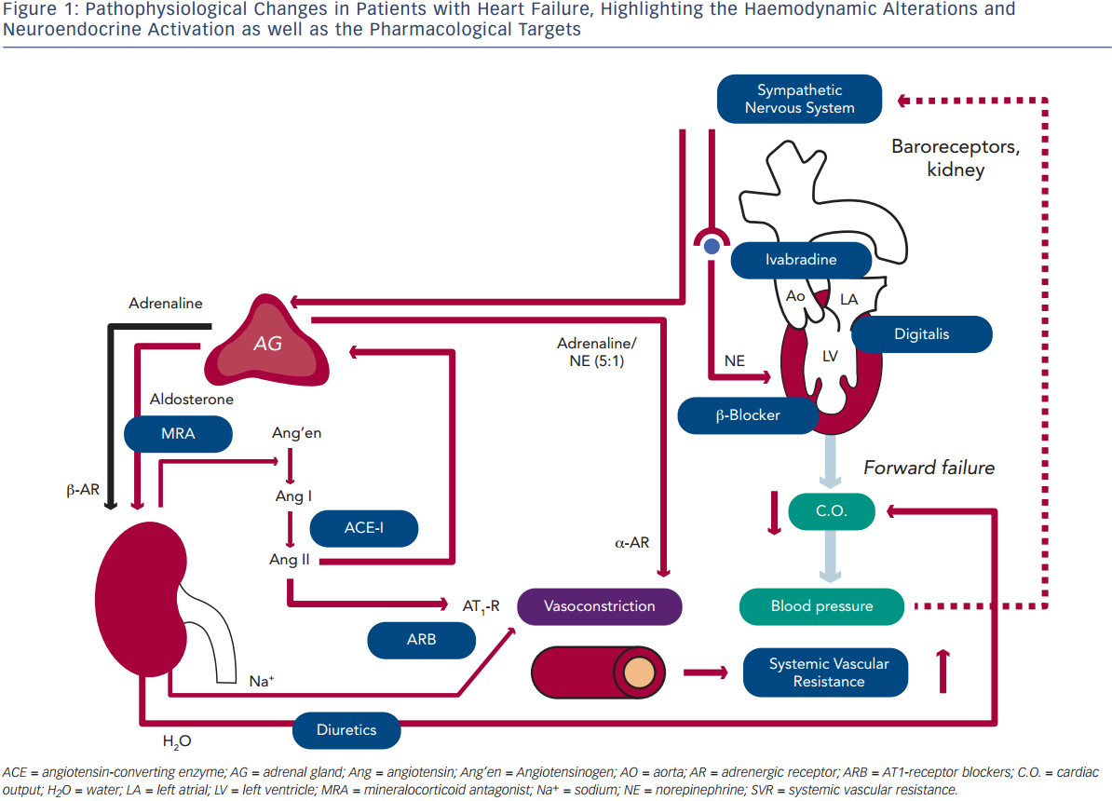
Maack C, Böhm M
Figure 1: Pathophysiological Changes in Patients with Heart Failure, Highlighting the Haemodynamic Alterations and Neuroendocrine Activation as well as the Pharmacological Targets
Citation: European Cardiology Review 2014;9(1):43–8
https://doi.org/10.15420/ecr.2014.9.1.43

