Slide 1
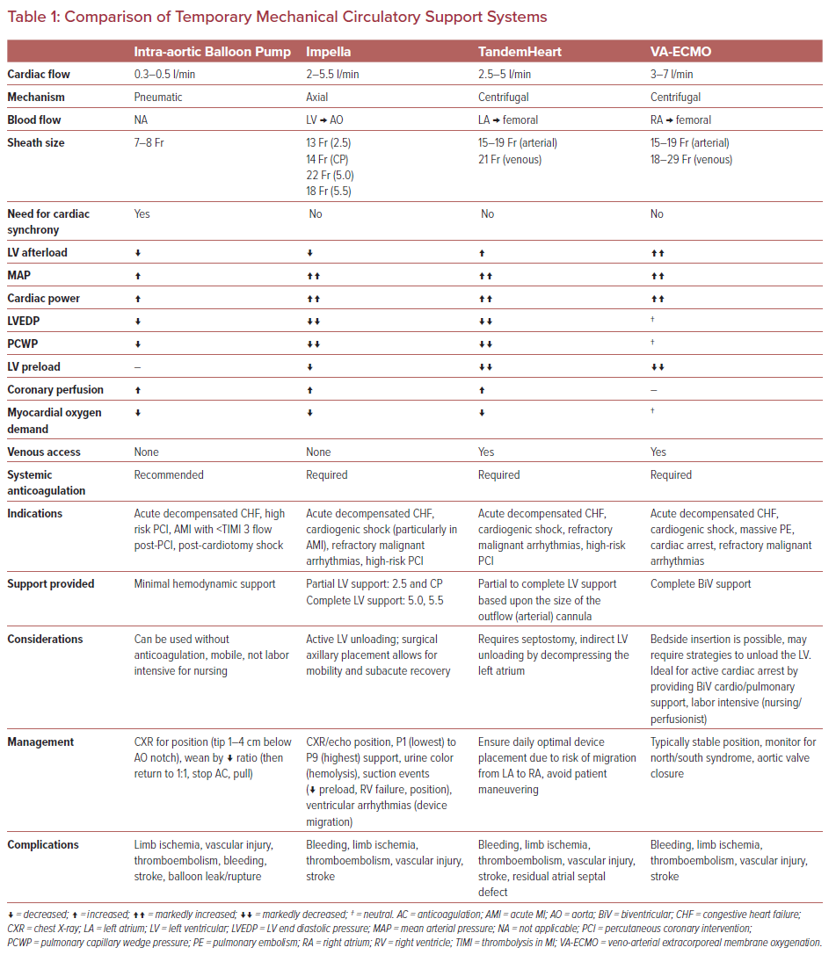
Upadhyay R, Alrayes H, Arno S, Kaushik M, Basir B
Comparison of Temporary Mechanical Circulatory Support Systems
Citation: US Cardiology Review 2021;15:e21.
https://doi.org/10.15420/usc.2021.15

