Slide 1
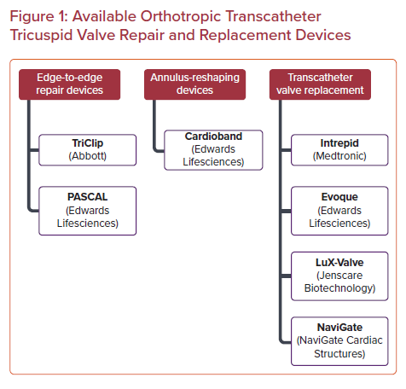
Rahgozar K, Bruoha S, Ho EC, Goldberg Y, Chau M, Latib A
Available Orthotropic Transcatheter Tricuspid Valve Repair and Replacement Devices
Citation: US Cardiology Review 2021;15:e22.
https://doi.org/10.15420/usc.2021.06

