Slide 1
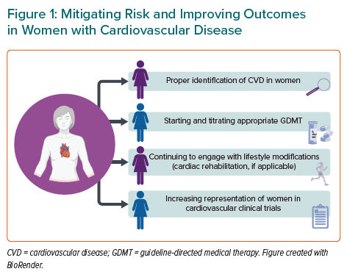
Thakkar A, Agarwala A, Michos ED
Mitigating Risk and Improving Outcomes in Women with Cardiovascular Disease
Citation: European Cardiology Review 2021;16:e41.
https://doi.org/10.15420/ecr.2021.24

