Slide 1
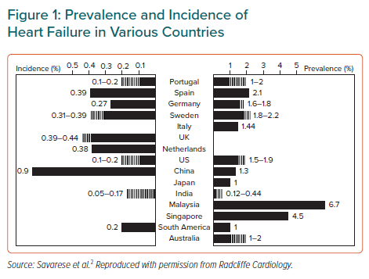
Kong X, Hu X, Hua B, Fedele F, Farmakis DT, Pollesello P
Prevalence and Incidence of Heart Failure in Various Countries
Citation: European Cardiology Review 2021;16:e42.
https://doi.org/10.15420/ecr.2021.41

