Slide 1
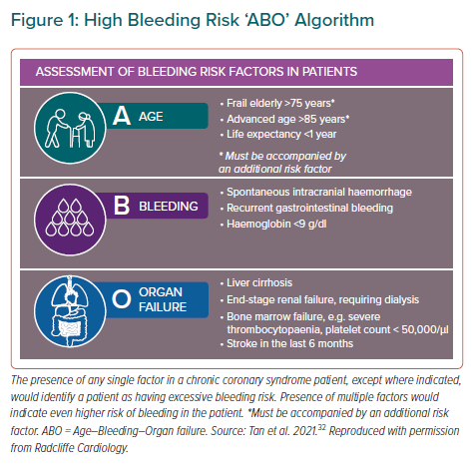
Tan JW, Chew DP, Tsui KL, Tan DSY, Duplyakov D, Hammoudeh A, Zhang B, Li Y, Xu K, Ong PJ, Firman D, Gamra H, Almahmeed W, Dalal JJ, Tam LW, Steg PG, Nguyen QN, Ako J, Al Suwaidi J, Chan M, Sobhy M, Shehab A, Buddhari W, Wang Z, Fong AYY, Karadag B, Kim BK, Baber U, Chin CT, Han YL
High Bleeding Risk ‘ABO’ Algorithm
Citation: European Cardiology Review 2021;16:e43.
https://doi.org/10.15420/ecr.2021.35

