Slide 1
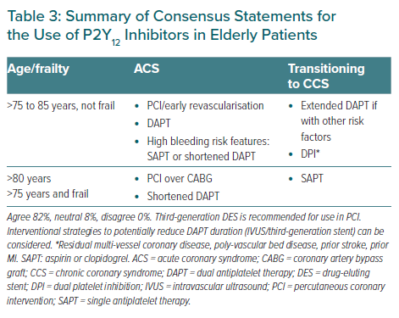
Tan JW, Chew DP, Tsui KL, Tan DSY, Duplyakov D, Hammoudeh A, Zhang B, Li Y, Xu K, Ong PJ, Firman D, Gamra H, Almahmeed W, Dalal JJ, Tam LW, Steg PG, Nguyen QN, Ako J, Al Suwaidi J, Chan M, Sobhy M, Shehab A, Buddhari W, Wang Z, Fong AYY, Karadag B, Kim BK, Baber U, Chin CT, Han YL
Summary of Consensus Statements for the Use of P2Y12 Inhibitors in Elderly Patients
Citation: European Cardiology Review 2021;16:e43.
https://doi.org/10.15420/ecr.2021.35

