Slide 1
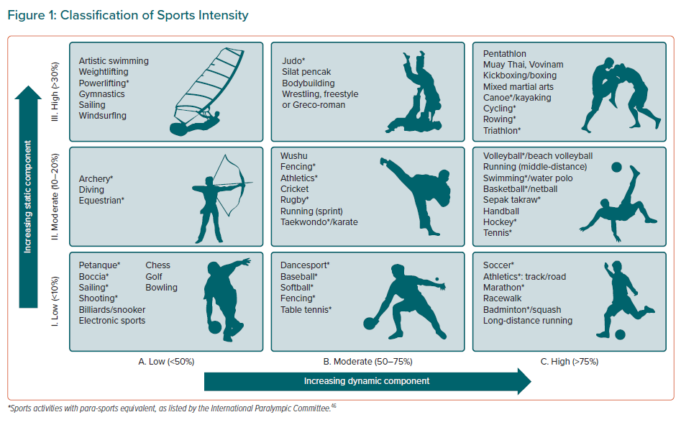
Wang L, Yeo TJ, Tan B, Destrube B, Tong KL, Tan SY, Chan G, Huang Z, Tan F, Wang YC, Lee JY, Fung E, Mak GYK, So R, Wanlapakorn C, Ambari AM, Cuenza L, Koh CH, Tan JW
Classification of Sports Intensity
Citation: European Cardiology Review 2021;16:e44.
https://doi.org/10.15420/ecr.2021.26

