Slide 1
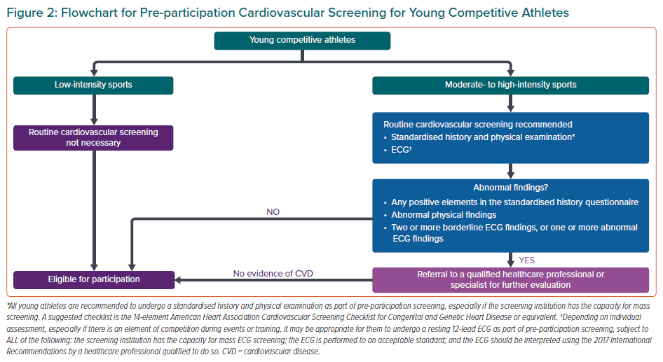
Wang L, Yeo TJ, Tan B, Destrube B, Tong KL, Tan SY, Chan G, Huang Z, Tan F, Wang YC, Lee JY, Fung E, Mak GYK, So R, Wanlapakorn C, Ambari AM, Cuenza L, Koh CH, Tan JW
Flowchart for Pre-participation Cardiovascular Screening for Young Competitive Athletes
Citation: European Cardiology Review 2021;16:e44.
https://doi.org/10.15420/ecr.2021.26

