Slide 1
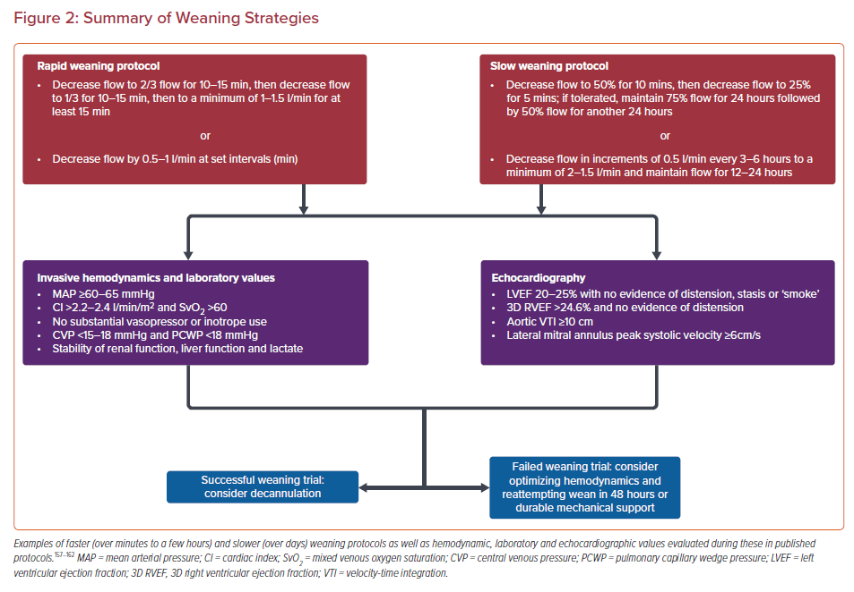
Elliott A, Dahyia G, Kalra R, Alexy T, Bartos J, Kosmopoulos M, Yannopoulos D
Summary of Weaning Strategies
Citation: US Cardiology Review 2021;15:e23.
https://doi.org/10.15420/usc.2021.13

