Slide 1
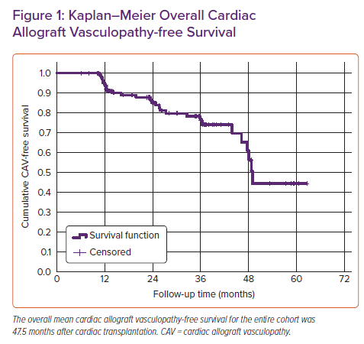
Ellimuttil TM, Harrison K, Rollins AT, Feurer ID, Rega SA, Gray J, Menachem JN
Kaplan–Meier Overall Cardiac Allograft Vasculopathy-free Survival
Citation: Cardiac Failure Review 2021;7:e15.
https://doi.org/10.15420/cfr.2021.07

