Slide 1
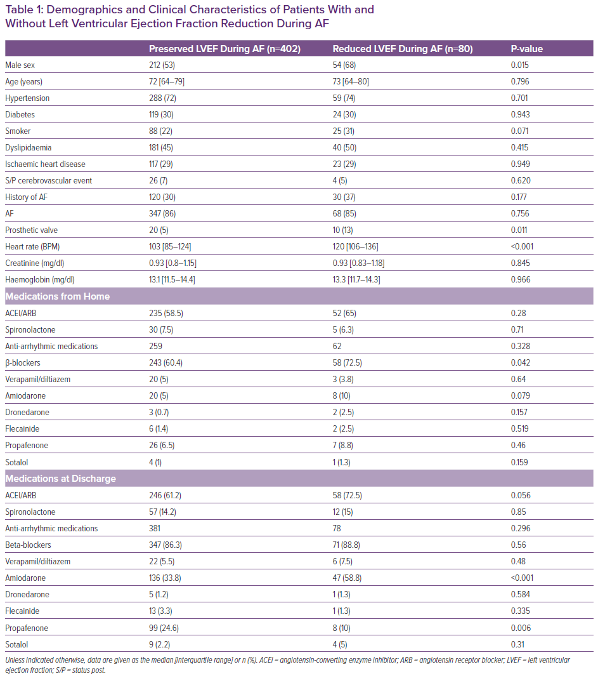
Marcusohn E, Kobo O, Postnikov M, Epstein D, Agmon Y, Gepstein L, Hellman Y, Zukermann R
Demographics and Clinical Characteristics of Patients With and Without Left Ventricular Ejection Fraction Reduction During AF
Citation: Cardiac Failure Review 2021;7:e16.
https://doi.org/10.15420/cfr.2021.17

