Slide 1
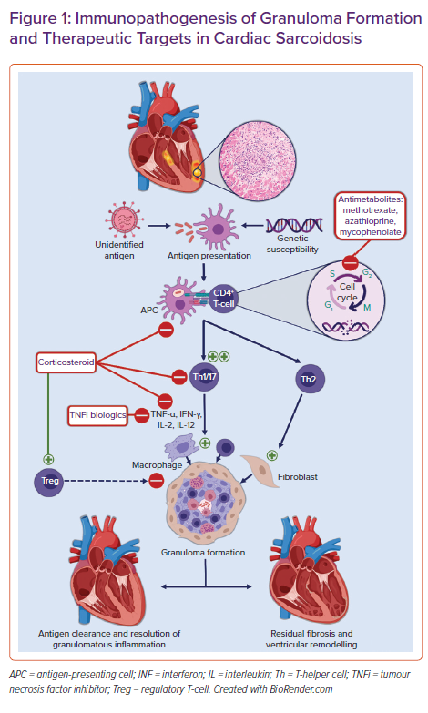
Giblin GT, Murphy L, Stewart GC, Desai AS, Di Carli MF, Blankstein R, Givertz MM, Tedrow UB, Sauer WH, Hunninghake GM, Dellaripa PF, Divakaran S, Lakdawala NK
Immunopathogenesis of Granuloma Formation and Therapeutic Targets in Cardiac Sarcoidosis
Citation: Cardiac Failure Review 2021;7:e17.
https://doi.org/10.15420/cfr.2021.16

