Slide 1
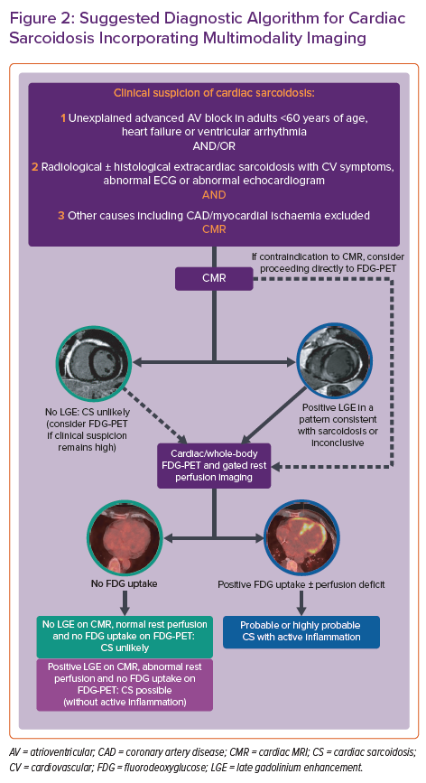
Giblin GT, Murphy L, Stewart GC, Desai AS, Di Carli MF, Blankstein R, Givertz MM, Tedrow UB, Sauer WH, Hunninghake GM, Dellaripa PF, Divakaran S, Lakdawala NK
Suggested Diagnostic Algorithm for Cardiac Sarcoidosis Incorporating Multimodality Imaging
Citation: Cardiac Failure Review 2021;7:e17.
https://doi.org/10.15420/cfr.2021.16

