Slide 1
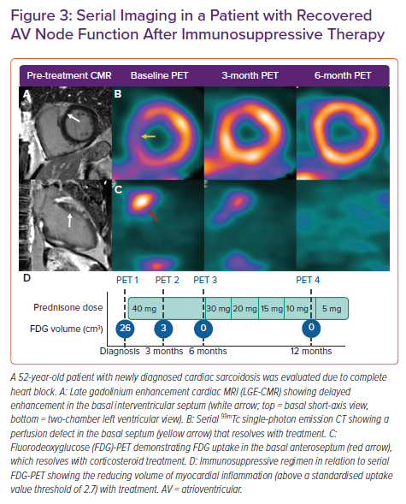
Giblin GT, Murphy L, Stewart GC, Desai AS, Di Carli MF, Blankstein R, Givertz MM, Tedrow UB, Sauer WH, Hunninghake GM, Dellaripa PF, Divakaran S, Lakdawala NK
Serial Imaging in a Patient with Recovered AV Node Function After Immunosuppressive Therapy
Citation: Cardiac Failure Review 2021;7:e17.
https://doi.org/10.15420/cfr.2021.16

