Slide 1
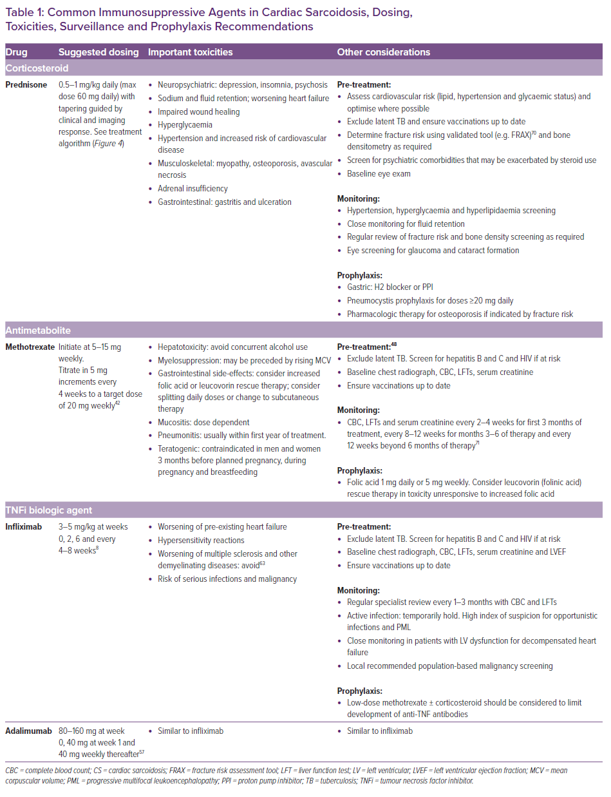
Giblin GT, Murphy L, Stewart GC, Desai AS, Di Carli MF, Blankstein R, Givertz MM, Tedrow UB, Sauer WH, Hunninghake GM, Dellaripa PF, Divakaran S, Lakdawala NK
Common Immunosuppressive Agents in Cardiac Sarcoidosis, Dosing, Toxicities, Surveillance and Prophylaxis Recommendations
Citation: Cardiac Failure Review 2021;7:e17.
https://doi.org/10.15420/cfr.2021.16

