Slide 1
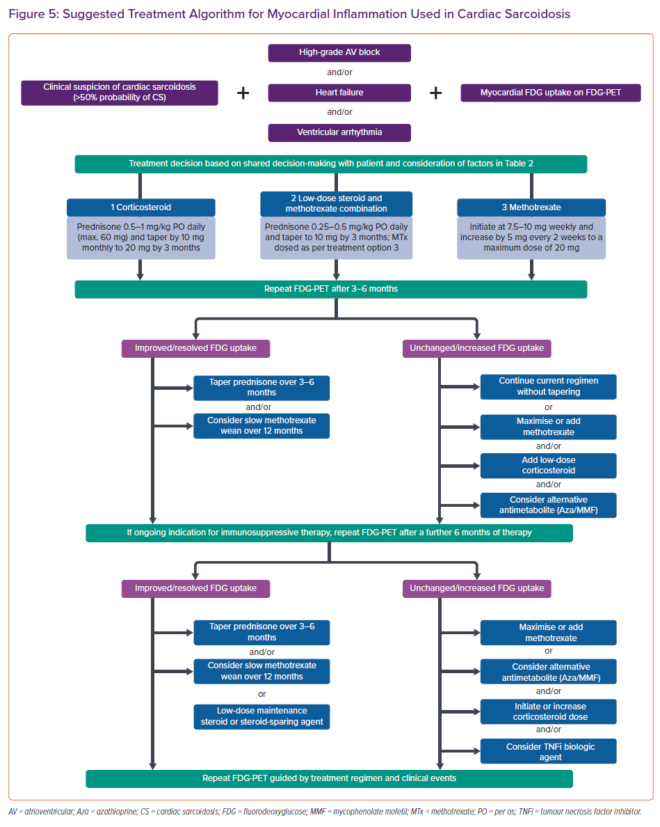
Giblin GT, Murphy L, Stewart GC, Desai AS, Di Carli MF, Blankstein R, Givertz MM, Tedrow UB, Sauer WH, Hunninghake GM, Dellaripa PF, Divakaran S, Lakdawala NK
Suggested Treatment Algorithm for Myocardial Inflammation Used in Cardiac Sarcoidosis
Citation: Cardiac Failure Review 2021;7:e17.
https://doi.org/10.15420/cfr.2021.16

