Slide 1
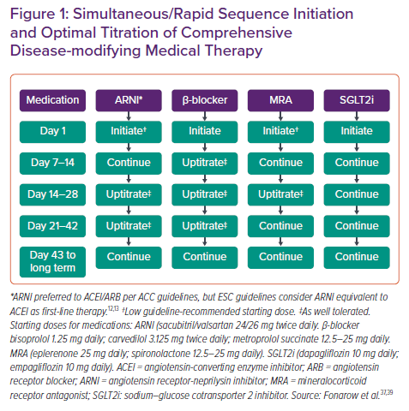
Brownell NK, Ziaeian B, Fonarow GC
Simultaneous/Rapid Sequence Initiation and Optimal Titration of Comprehensive Disease-modifying Medical Therapy
Citation: Cardiac Failure Review 2021;7:e18.
https://doi.org/10.15420/cfr.2021.18

