Slide 1
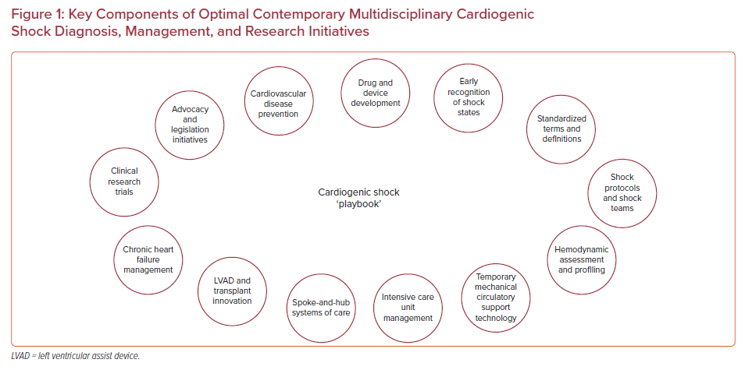
Truesdell AG
Key Components of Optimal Contemporary Multidisciplinary Cardiogenic Shock Diagnosis, Management, and Research Initiatives
Citation: US Cardiology Review 2021;15:e24.
https://doi.org/10.15420/usc.2020.28

