Slide 1
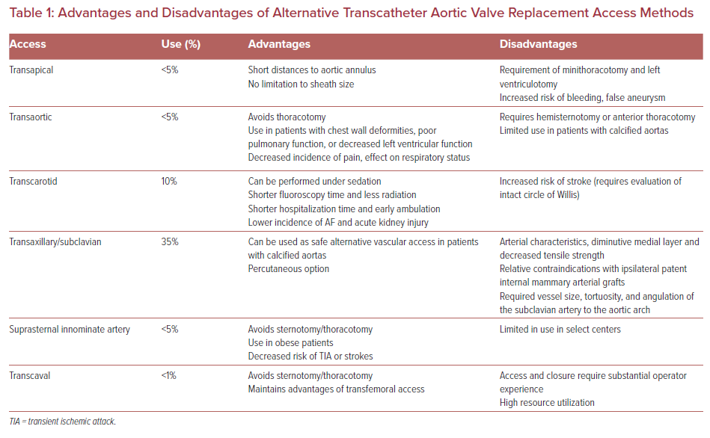
Payabyab EC, Elbaum LS, Sharma N, George I, Mick SL
Advantages and Disadvantages of Alternative Transcatheter Aortic Valve Replacement Access Methods
Citation: US Cardiology Review 2021;15:e25.
https://doi.org/10.15420/usc.2021.16

