Slide 1
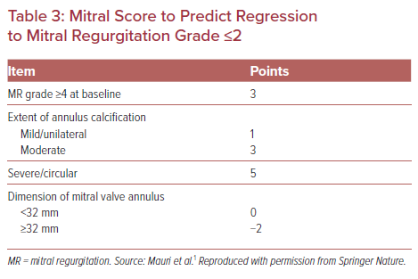
Masson JB, Forcillo J
Mitral Score to Predict Regression to Mitral Regurgitation Grade ≤2
Citation: US Cardiology Review 2021;15:e26.
https://doi.org/10.15420/usc.2021.17

