Slide 1
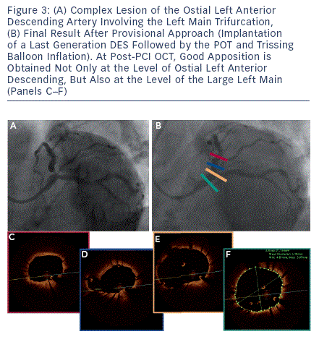
Burzotta F, Trani C
Technical Aspects of Provisional Stenting in Percutaneous Treatment of Complex Bifurcation Lesions
Citation: Interventional Cardiology Review 2013;8(2):96-9
https://doi.org/10.15420/icr.2013.8.2.96

