Slide 1
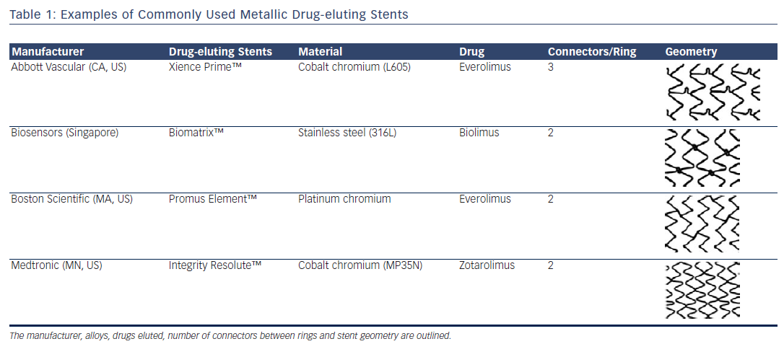
Noad RL, Hanratty C, Walsh SJ
Table 1: Examples of Commonly Used Metallic Drug-eluting Stents
Citation: Interventional Cardiology Review 2014;9(2):89–93
https://doi.org/10.15420/icr.2011.9.2.89

