Slide 1
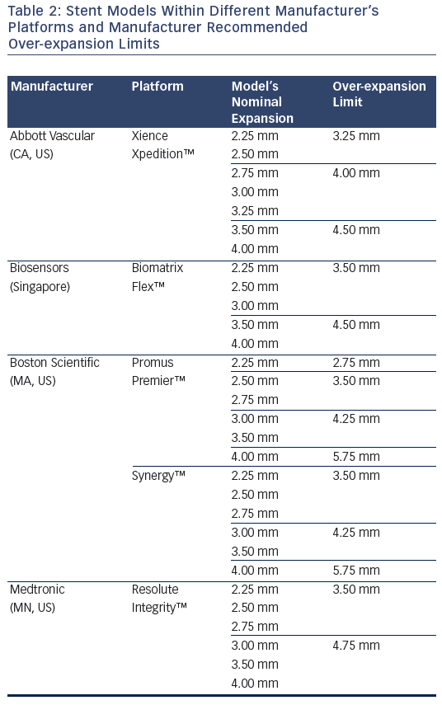
Noad RL, Hanratty C, Walsh SJ
Table 2: Stent Models Within Different Manufacturer’s Platforms and Manufacturer Recommended Over-expansion Limits
Citation: Interventional Cardiology Review 2014;9(2):89–93
https://doi.org/10.15420/icr.2011.9.2.89

