Slide 1
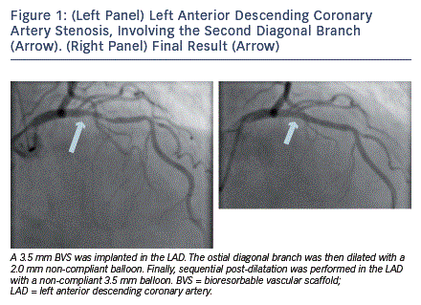
Schmermund A, Eggebrecht H
(Left Panel) Left Anterior Descending Coronary Artery Stenosis, Involving the Second Diagonal Branch (Arrow). (Right Panel) Final Result (Arrow)
Citation: Interventional Cardiology Review 2013;8(2):87-9
https://doi.org/10.15420/icr.2013.8.2.87

