Slide 1
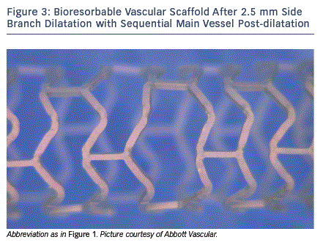
Schmermund A, Eggebrecht H
The Role of Bioresorbable Scaffolds in Meeting the Challenges of Bifurcations
Citation: Interventional Cardiology Review 2013;8(2):87-9
https://doi.org/10.15420/icr.2013.8.2.87

