Slide 1
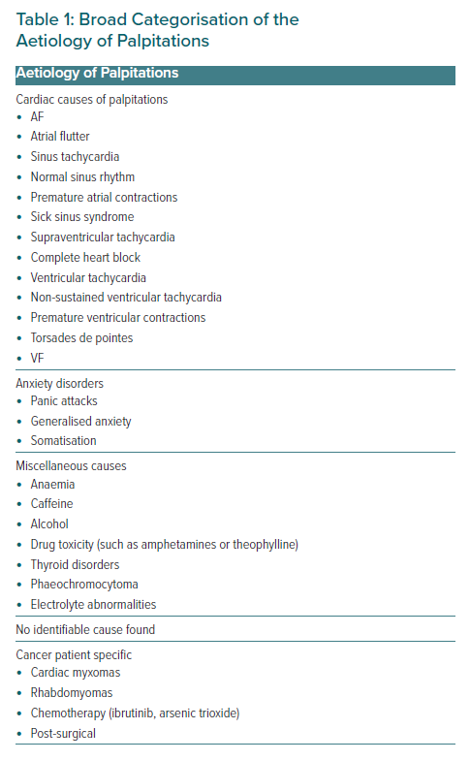
Essa H, Lip GY
Broad Categorisation of the Aetiology of Palpitations
Citation: European Cardiology Review 2021;16:e45.
https://doi.org/10.15420/ecr.2021.44

