Slide 1

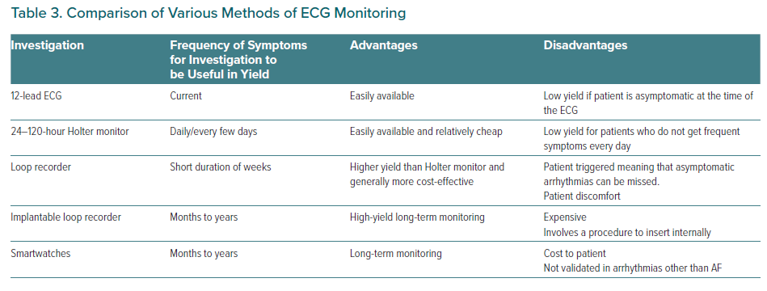
Essa H, Lip GY
Comparison of Various Methods of ECG Monitoring
Citation: European Cardiology Review 2021;16:e45.
https://doi.org/10.15420/ecr.2021.44

