Slide 1
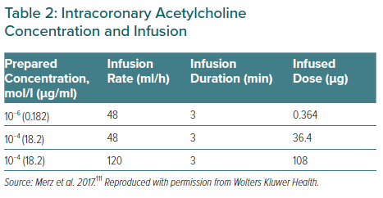
Aldiwani H, Mahdai S, Alhatemi G, Bairey Merz CN
Intracoronary Acetylcholine Concentration and Infusion
Citation: European Cardiology Review 2021;16:e46.
https://doi.org/10.15420/ecr.2021.15

